Slide 1
MongoDB
Big Data Analytics(BDA)
GTU #3170722

Slide 2
Introduction

Slide 3
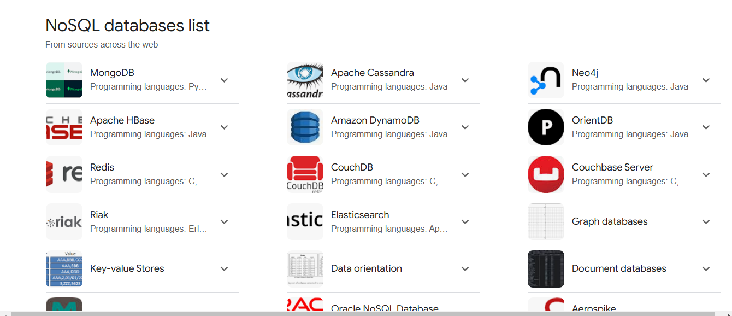

Slide 4
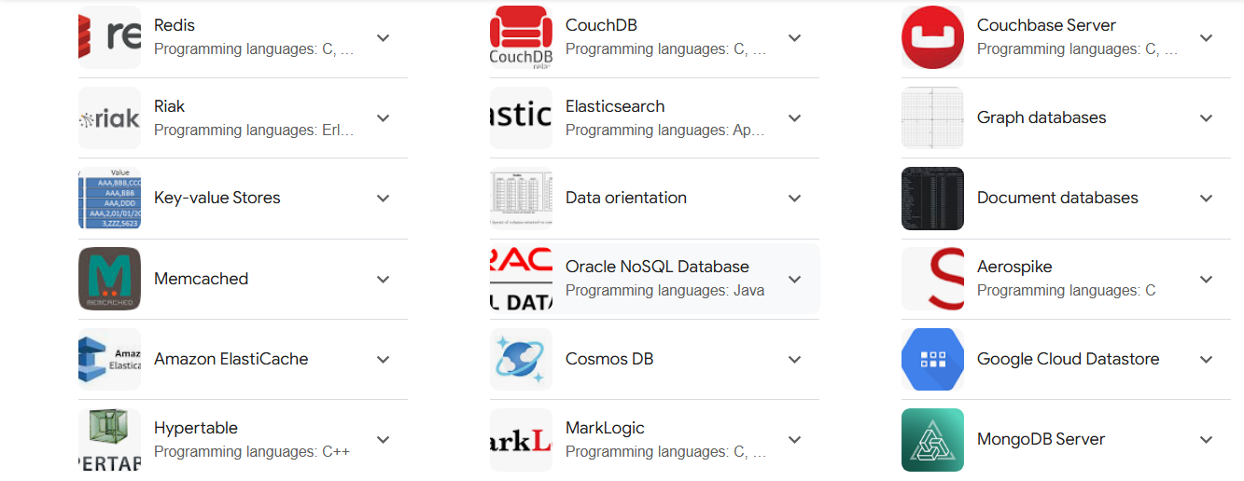

Slide 5
Intro
MongoDB is an open-source document-oriented database that is designed to store a large scale of data and also allows you to work with that data very efficiently.
It is categorized under the NoSQL (Not only SQL) database because the storage and retrieval of data in the MongoDB are not in the form of tables.
The MongoDB database is developed and managed by MongoDB.Inc under SSPL(Server Side Public License) and initially released in February 2009.
It also provides official driver support for all the popular languages like C, C++, C#, and .Net, Go, Java, Node.js, Perl, PHP, Python, Motor, Ruby, Scala, Swift, Mongoid. So, that you can create an application using any of these languages.
Nowadays there are so many companies that used MongoDB like Facebook, Nokia, eBay, Adobe, Google, etc. to store their large amount of data.

Slide 6
How it works ?

Slide 7
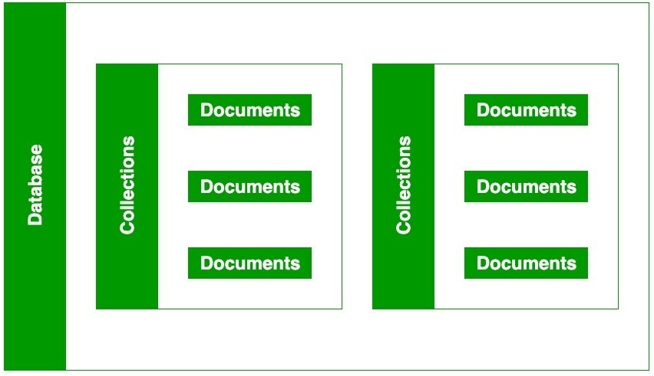
How it works ?
As we know that MongoDB is a database server and the data is stored in these databases. Or in other words, MongoDB environment gives you a server that you can start and then create multiple databases on it using MongoDB.
Because of its NoSQL database, the data is stored in the collections and documents. Hence the database, collection, and documents are related to each other as shown below:
The MongoDB database contains collections just like the MYSQL database contains tables. You are allowed to create multiple databases and multiple collections.
Now inside of the collection we have documents. These documents contain the data we want to store in the MongoDB database and a single collection can contain multiple documents and you are schema-less means it is not necessary that one document is similar to another.

Slide 8
How it works ?
The documents are created using the fields. Fields are key-value pairs in the documents, it is just like columns in the relation database. The value of the fields can be of any BSON data types like double, string, boolean, etc.
The data stored in the MongoDB is in the format of BSON documents. Here, BSON stands for Binary representation of JSON documents. Or in other words, in the backend, the MongoDB server converts the JSON data into a binary form that is known as BSON and this BSON is stored and queried more efficiently.
In MongoDB documents, you are allowed to store nested data. This nesting of data allows you to create complex relations between data and store them in the same document which makes the working and fetching of data extremely efficient as compared to SQL. In SQL, you need to write complex joins to get the data from table 1 and table 2. The maximum size of the BSON document is 16MB.

Slide 9
How Multiple data works

Slide 10
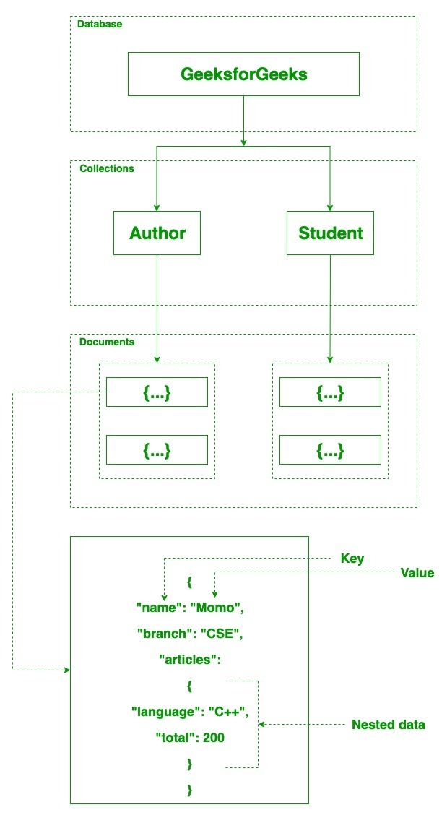
How Multiple data works
In MongoDB server, you are allowed to run multiple databases.
For example, we have a database named GeeksforGeeks. Inside this database, we have two collections and in these collections we have two documents. And in these documents we store our data in the form of fields. As shown in the below image:

Slide 11
Types of Database in NoSQL

Slide 12
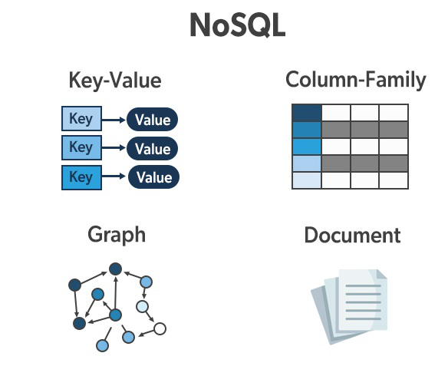
Types of NoSQL Database
Document-based databases
Key-value stores
Column-oriented databases
Graph-based databases

Slide 13
Types
Here are some of the common database types that come under NoSQL:
Document type databases: Here, the key gets paired with a compound data structure, i.e., document. MongoDB is an example of such type.
Key-Value stores: Here, each unstructured data is stored with a key for recognizing it.
Graph stores: In this type of database, data is stored mostly for networked data. It helps to relate data based on some existing data.
Wide-column stores: This type of data stores large data sets Cassandra (Used by Facebook), HBase are examples of such type

Slide 14
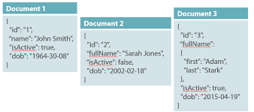
Document-Based Database
The document-based database is a non-relational database. Instead of storing the data in rows and columns (tables), it uses the documents to store the data in the database.
A document database stores data in JSON, BSON, or XML documents.
In the Document database, the particular elements can be accessed by using the index value that is assigned for faster querying.
Collections are the group of documents that store documents that have similar contents.
Not all the documents are in any collection as they require a similar schema because document databases have a flexible schema.

Slide 15
Key features of documents database
Flexible schema: Documents in the database has a flexible schema. It means the documents in the database need not be the same schema.
Faster creation and maintenance: the creation of documents is easy and minimal maintenance is required once we create the document.
No foreign keys: There is no dynamic relationship between two documents so documents can be independent of one another. So, there is no requirement for a foreign key in a document database.
Open formats: To build a document we use XML, JSON, and others.

Slide 16
Some document-based databases
MongoDB Atlas
Amazon DynamoDB
Google Cloud Firestore
Couchbase Server: A document database that stores data as JSON documents in keyspaces
CouchDB: A document-oriented database used by Apache that supports a variety of data types
Microsoft Azure Cosmos DB: A NoSQL document database that offers the speed and scalability of a schema-free database
CrateDB: A NoSQL database that uses a document-oriented approach instead of rows and columns
Amazon DocumentDB: A managed MongoDB service that provides features such as content management, catalogs, and user profiles

Slide 17
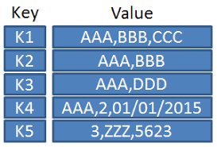
Key-Value Stores
A key-value store is a nonrelational database.
The simplest form of a NoSQL database is a key-value store.
Every data element in the database is stored in key-value pairs.
The data can be retrieved by using a unique key allotted to each element in the database. The values can be simple data types like strings and numbers or complex objects.
A key-value store is like a relational database with only two columns which is the key and the value.
Key features of the key-value store:
Simplicity.
Scalability.
Speed.

Slide 18
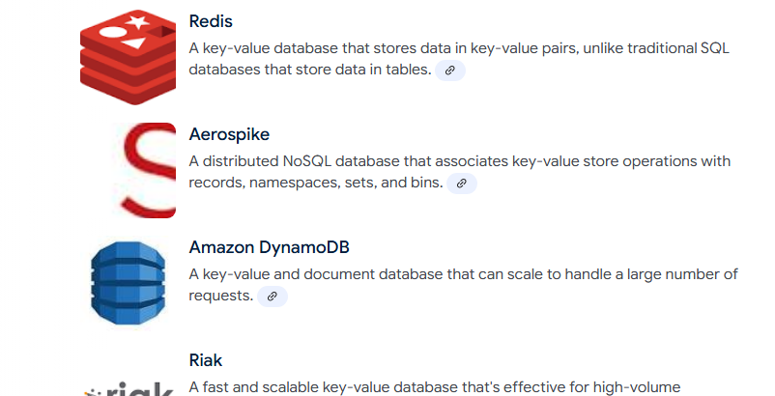
Some Key-Value databases

Slide 19
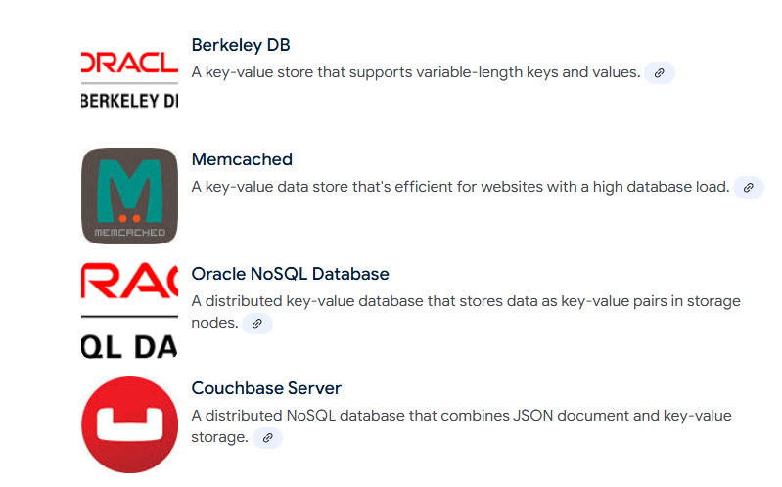
Some Key-Value databases

Slide 20
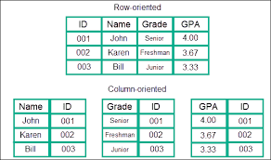
Column Oriented Databases
A column-oriented database is a non-relational database that stores the data in columns instead of rows.
That means when we want to run analytics on a small number of columns, you can read those columns directly without consuming memory with the unwanted data.
Columnar databases are designed to read data more efficiently and retrieve the data with greater speed.
A columnar database is used to store a large amount of data.
Key features of columnar oriented database:
Scalability.
Compression.
Very responsive.

Slide 21
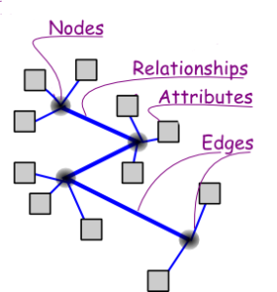
Graph-Based databases
Graph-based databases focus on the relationship between the elements.
It stores the data in the form of nodes in the database. The connections between the nodes are called links or relationships.
Key features of graph database:
In a graph-based database, it is easy to identify the relationship between the data by using the links.
The Query’s output is real-time results.
The speed depends upon the number of relationships among the database elements.
Updating data is also easy, as adding a new node or edge to a graph database is a straightforward task that does not require significant schema changes.

Slide 22
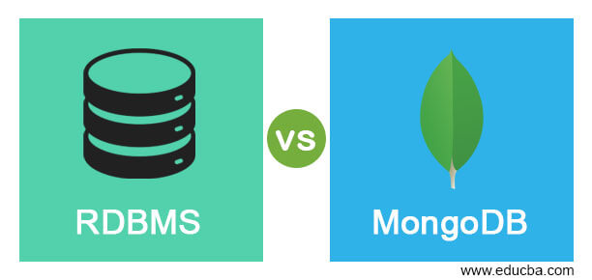
mongoDB Vs RDBMS ?

Slide 23
mongoDB Vs RDBMS ?
MongoDB | RDBMS
It is a non-relational and document-oriented database. | It is a relational database.
It is suitable for hierarchical data storage. | It is not suitable for hierarchical data storage.
It has a dynamic schema. | It has a predefined schema.
It centers around the CAP theorem (Consistency, Availability, and Partition tolerance). | It centers around ACID properties (Atomicity, Consistency, Isolation, and Durability).
In terms of performance, it is much faster than RDBMS. | In terms of performance, it is slower than MongoDB.

Slide 24

Features of MongoDB

Slide 25
Features
Schema-less Database:
It is the great feature provided by the MongoDB.
A Schema-less database means one collection can hold different types of documents in it.
Or in other words, in the MongoDB database, a single collection can hold multiple documents and these documents may consist of the different numbers of fields, content, and size.
It is not necessary that the one document is similar to another document like in the relational databases.
Due to this cool feature, MongoDB provides great flexibility to databases.
Document Oriented:
In MongoDB, all the data stored in the documents instead of tables like in RDBMS.
In these documents, the data is stored in fields(key-value pair) instead of rows and columns which make the data much more flexible in comparison to RDBMS. And each document contains its unique object id.

Slide 26
Features
Indexing:
In MongoDB database, every field in the documents is indexed with primary and secondary indices this makes easier and takes less time to get or search data from the pool of the data.
If the data is not indexed, then database search each document with the specified query which takes lots of time and not so efficient.
Scalability:
MongoDB provides horizontal scalability with the help of sharding.
Sharding means to distribute data on multiple servers, here a large amount of data is partitioned into data chunks using the shard key, and these data chunks are evenly distributed across shards that reside across many physical servers.
It will also add new machines to a running database.

Slide 27
Features
Replication:
MongoDB provides high availability and redundancy with the help of replication, it creates multiple copies of the data and sends these copies to a different server so that if one server fails, then the data is retrieved from another server.
Aggregation:
It allows to perform operations on the grouped data and get a single result or computed result.
It is similar to the SQL GROUPBY clause.
It provides three different aggregations i.e, aggregation pipeline, map-reduce function, and single-purpose aggregation methods
High Performance: The performance of MongoDB is very high and data persistence as compared to another database due to its features like scalability, indexing, replication, etc

Slide 28
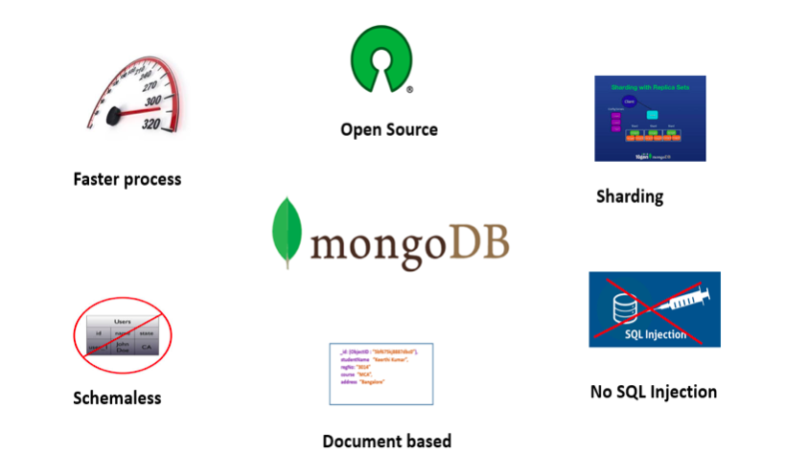
Advantages and Disadvantages of MongoDB

Slide 29
Advantages of MongoDB
It is a schema-less NoSQL database. You need not to design the schema of the database when you are working with MongoDB.
It does not support join operation.
It provides great flexibility to the fields in the documents.
It contains heterogeneous data.
It provides high performance, availability, scalability.
It supports Geospatial efficiently.
It is a document oriented database and the data is stored in BSON documents.
It also supports multiple document ACID transition(string from MongoDB 4.0).
It does not require any SQL injection.
It is easily integrated with Big Data Hadoop

Slide 30
Disadvantages of MongoDB
It uses high memory for data storage.
You are not allowed to store more than 16MB data in the documents.
The nesting of data in BSON is also limited you are not allowed to nest data more than 100 levels.

Slide 31
USE CASES

Slide 32
Where to use
E-Commerce applications
Blog & Content Management systems
High speed logging in the real time
Location wise geospatial data
Social & Networking website
Applications that have changing or flexible schema

Slide 33
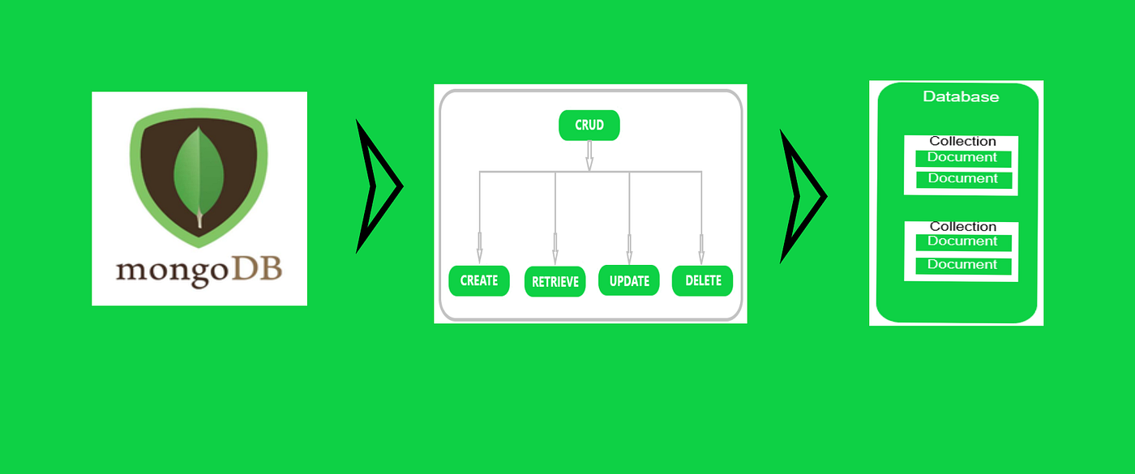
CRUD

Slide 34
CRUD
The basic. methods of interacting with a MongoDB server are called CRUD operations.
CRUD stands for Create, Read, Update, and Delete.
CRUD operations describe the conventions of a user-interface that let users view, search, and modify parts of the database.
MongoDB documents are modified by connecting to a server, querying the proper documents, and then changing the setting properties before sending the data back to the database to be updated. CRUD is data-oriented, and it’s standardized according to HTTP action verbs.

Slide 35
CRUD
When it comes to the individual CRUD operations:
The Create operation is used to insert new documents in the MongoDB database.
The Read operation is used to query a document in the database.
The Update operation is used to modify existing documents in the database.
The Delete operation is used to remove documents in the database.

Slide 36
How to Perform CRUD Operations

Slide 37
Create Database
1. MongoDB - Create Database
use product
2. If you want to check your databases list, use the command
show dbs
3. MongoDB - Drop Database
db.dropDatabase()
4. MongoDB - Create Collection
db.createCollection(name)
db.createCollection("students")
5. MongoDB -Show Collection
show collections
6. MongoDB - Drop Collection
db.students.drop()

Slide 38
Create Operations
For MongoDB CRUD, if the specified collection doesn’t exist, the create operation will create the collection when it’s executed. Create operations in MongoDB target a single collection, not multiple collections. Insert operations in MongoDB are atomic on a single document level.
MongoDB provides two different create operations that you can use to insert documents into a collection:
db.collection.insertOne()
db.collection.insertMany()

Slide 39
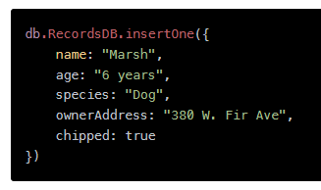
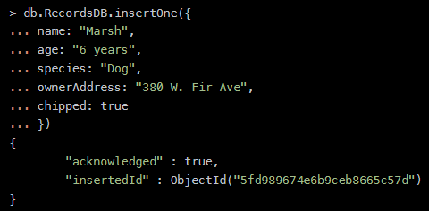
insertOne()
As the namesake, insertOne() allows to insert one document into the collection. For this example, we’re going to work with a collection called RecordsDB. We can insert a single entry into our collection by calling the insertOne() method on RecordsDB. We then provide the information we want to insert in the form of key-value pairs, establishing the schema.
If the create operation is successful, a new document is created. The function will return an object where “acknowledged” is “true” and “insertID” is the newly created “ObjectId.”

Slide 40
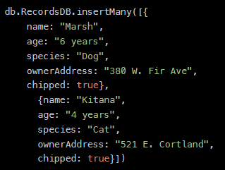
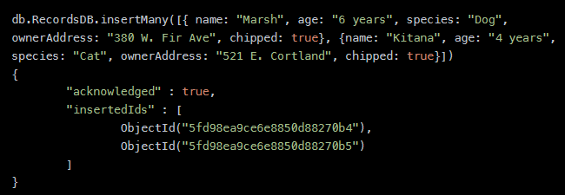
insertMany()
It’s possible to insert multiple items at one time by calling the insertMany() method on the desired collection.
In this case, we pass multiple items into our chosen collection (RecordsDB) and separate them by commas.
Within the parentheses, we use brackets to indicate that we are passing in a list of multiple entries.
This is commonly referred to as a nested method.

Slide 41
Read Operations
The read operations allow you to supply special query filters and criteria that let you specify which documents you want. The MongoDB documentation contains more information on the available query filters. Query modifiers may also be used to change how many results are returned.
MongoDB has two methods of reading documents from a collection:
db.collection.find()
db.collection.findOne()

Slide 42
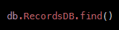
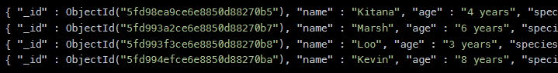
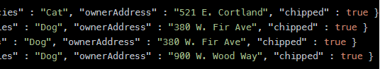
find()
In order to get all the documents from a collection, we can simply use the find() method on our chosen collection.
Executing just the find() method with no arguments will return all records currently in the collection.
Here we can see that every record has an assigned “ObjectId” mapped to the “_id” key.

Slide 43
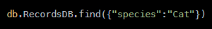
find()
If you want to get more specific with a read operation and find a desired subsection of the records, you can use the previously mentioned filtering criteria to choose what results should be returned. One of the most common ways of filtering the results is to search by value.

Slide 44
findOne()
In order to get one document that satisfies the search criteria, we can simply use the findOne() method on our chosen collection.
If multiple documents satisfy the query, this method returns the first document according to the natural order which reflects the order of documents on the disk.
If no documents satisfy the search criteria, the function returns null.

Slide 45
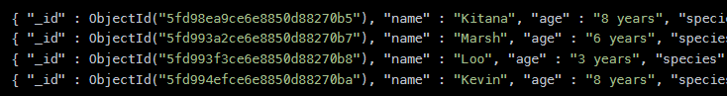
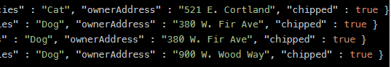
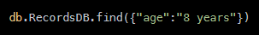
findOne()
The function takes the following form of syntax.
Let's take the following collection—say, RecordsDB, as an example.
And, we run the following line of code:
We would get the following result:
NOTE: Notice that even though two documents meet the search criteria, only the first document that matches the search condition is returned.

Slide 46
Update Operations()
Like create operations, update operations operate on a single collection, and they are atomic at a single document level.
An update operation takes filters and criteria to select the documents we want to update.
We should be careful when updating documents, as updates are permanent and can’t be rolled back. This applies to delete operations as well.
For MongoDB CRUD, there are three different methods of updating documents:
db.collection.updateOne()
db.collection.updateMany()
db.collection.replaceOne()

Slide 47

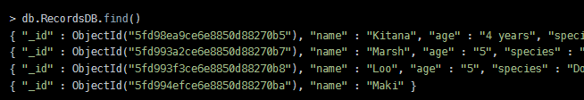
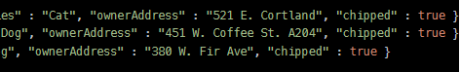
replaceOne()
The replaceOne() method is used to replace a single document in the specified collection. replaceOne() replaces the entire document, meaning fields in the old document not contained in the new will be lost.

Slide 48
updateOne()
We can update a currently existing record and change a single document with an update operation.
To do this, we use the updateOne() method on a chosen collection, which here is “RecordsDB.” To update a document, we provide the method with two arguments: an update filter and an update action.
The update filter defines which items we want to update, and the update action defines how to update those items.
We first pass in the update filter.
Then, we use the “$set” key and provide the fields we want to update as a value.
This method will update the first record that matches the provided filter.

Slide 49
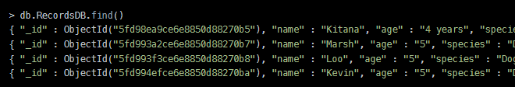
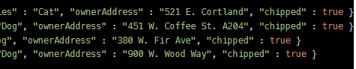
updateMany()
updateMany() allows us to update multiple items by passing in a list of items, just as we did when inserting multiple items.
This update operation uses the same syntax for updating a single document.

Slide 50
Delete Operations
Delete operations operate on a single collection, like update and create operations. Delete operations are also atomic for a single document. You can provide delete operations with filters and criteria in order to specify which documents you would like to delete from a collection. The filter options rely on the same syntax that read operations utilize.
MongoDB has two different methods of deleting records from a collection:
db.collection.deleteOne()
db.collection.deleteMany()

Slide 51

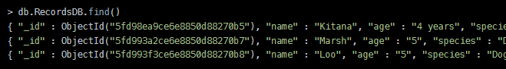
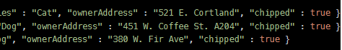
deleteOne()
deleteOne() is used to remove a document from a specified collection on the MongoDB server.
A filter criteria is used to specify the item to delete. It deletes the first record that matches the provided filter.

Slide 52

deleteMany()
deleteMany() is a method used to delete multiple documents from a desired collection with a single delete operation. A list is passed into the method and the individual items are defined with filter criteria as in deleteOne().

Slide 53
END

